Slide 1
Verilog HDL语言
华中科技大学计算机科学与技术学院

Slide 2
组合电路的Verilog设计

Slide 3
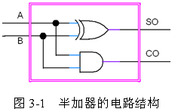
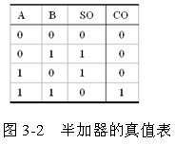
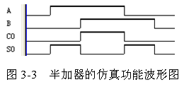
3.1 半加器电路的Verilog描述

Slide 4
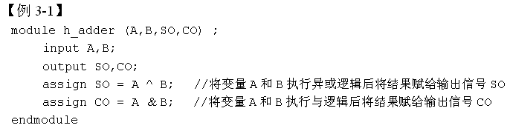
3.1 半加器电路的Verilog描述

Slide 5

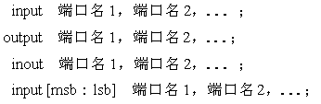
3.1 半加器电路的Verilog描述
1．模块语句及其表达方式
2．端口语句、端口信号名和端口模式

Slide 6

3.1 半加器电路的Verilog描述
3．逻辑操作符
4．连续赋值语句

Slide 7
3.1 半加器电路的Verilog描述
5．关键字
6．标识符
7．注释符号
8．规范的程序书写格式
9．文件取名和存盘

Slide 8
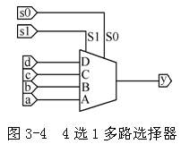
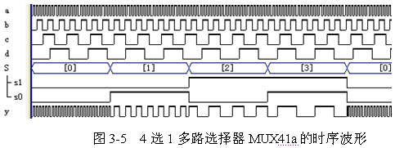
3.2 多路选择器的Verilog描述
3.2.1 4选1多路选择器及其case语句表述方式

Slide 9
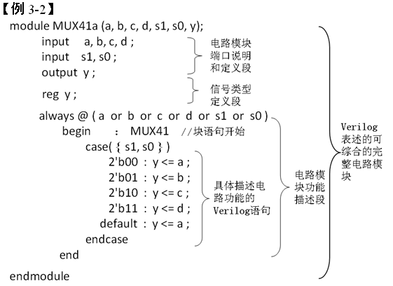
3.2 多路选择器的Verilog描述
3.2.1 4选1多路选择器及其case语句表述方式

Slide 10


3.2 多路选择器的Verilog描述
3.2.1 4选1多路选择器及其case语句表述方式
1．reg型变量定义
2．过程语句

Slide 11

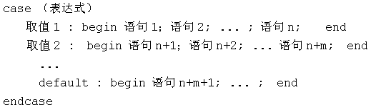
3.2 多路选择器的Verilog描述
3.2.1 4选1多路选择器及其case语句表述方式
3．块语句begin _end
4．case条件语句

Slide 12
3.2 多路选择器的Verilog描述
3.2.1 4选1多路选择器及其case语句表述方式
5．Verilog的4种逻辑状态
6．并位操作运算符
7．Verilog的数字表达形式

Slide 13
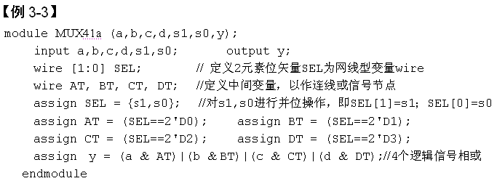
3.2 多路选择器的Verilog描述
3.2.2 4选1多路选择器及assign语句表述方式

Slide 14
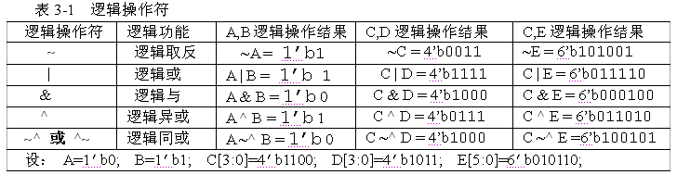
3.2 多路选择器的Verilog描述
3.2.2 4选1多路选择器及assign语句表述方式
1．按位逻辑操作符

Slide 15
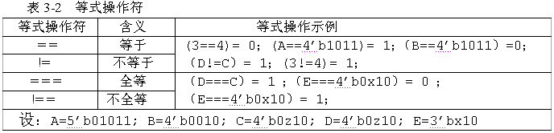
3.2 多路选择器的Verilog描述
3.2.2 4选1多路选择器及assign语句表述方式
2．等式操作符

Slide 16


3.2 多路选择器的Verilog描述
3.2.2 4选1多路选择器及assign语句表述方式
3．wire定义网线型变量

Slide 17
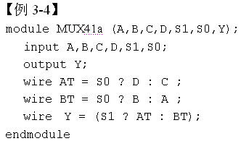
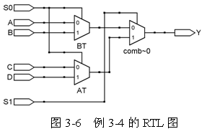
3.2 多路选择器的Verilog描述
3.2.3 4选1多路选择器及条件赋值语句表述方式

Slide 18
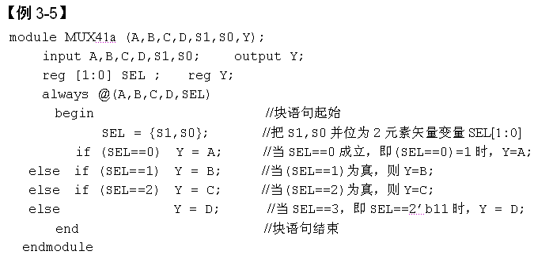
3.2 多路选择器的Verilog描述
3.2.4 4选1多路选择器及其条件语句表述方式

Slide 19

3.2 多路选择器的Verilog描述
3.2.4 4选1多路选择器及其条件语句表述方式
1．if条件语句
2．过程赋值语句
（1）阻塞式赋值。
（2）非阻塞式赋值。
3．数据类型表示方式

Slide 20
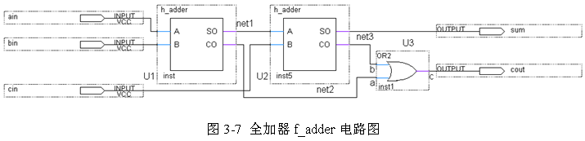
3.3 Verilog加法器设计
3.3.1 全加器设计及例化语句应用
1. 全加器原理图结构

Slide 21
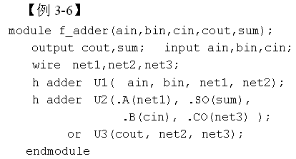
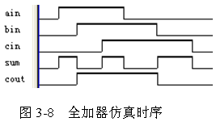
3.3 Verilog加法器设计
3.3.1 全加器设计及例化语句应用
2. 全加器顶层设计文件

Slide 22
3.3 Verilog加法器设计
3.3.1 全加器设计及例化语句应用
3. Verilog例化语句及其用法

Slide 23
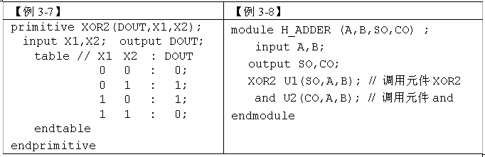
3.3 Verilog加法器设计
3.3.2 半加器的UDP结构建模描述方式
1．库元件及其调用
2．用户自定义原语

Slide 24
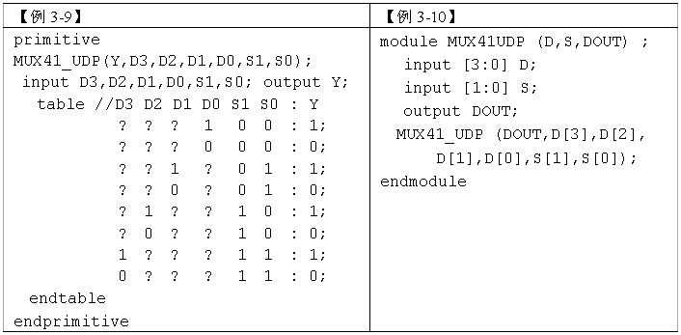
3.3 Verilog加法器设计
3.3.3 利用UDP元件设计多路选择器

Slide 25
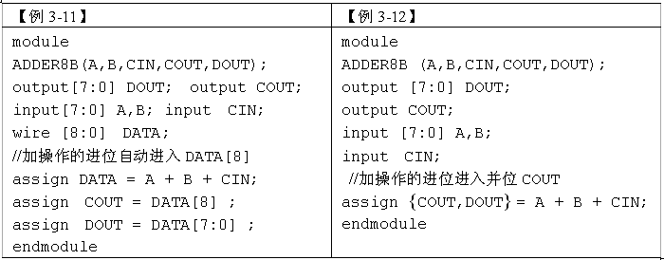
3.3 Verilog加法器设计
3.3.4 8位加法器设计及算术操作符应用

Slide 26
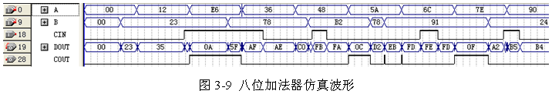
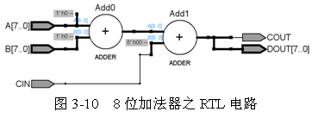
3.3 Verilog加法器设计
3.3.4 8位加法器设计及算术操作符应用

Slide 27
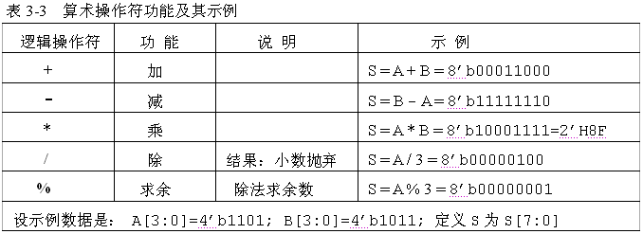
3.3 Verilog加法器设计
3.3.5 算术运算操作符

Slide 28
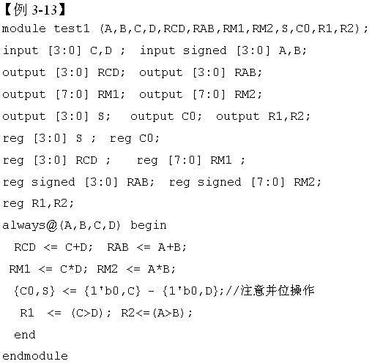
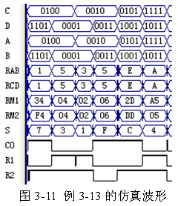
3.3 Verilog加法器设计
3.3.5 算术运算操作符

Slide 29
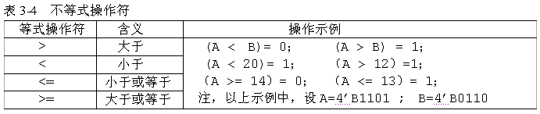
3.3 Verilog加法器设计
3.3.6 BCD码加法器设计

Slide 30
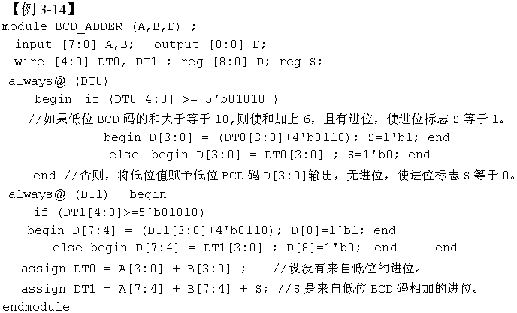

3.3 Verilog加法器设计
3.3.6 BCD码加法器设计

Slide 31

3.4 组合逻辑乘法器设计
3.4.1 参数定义关键词parameter和localparam

Slide 32
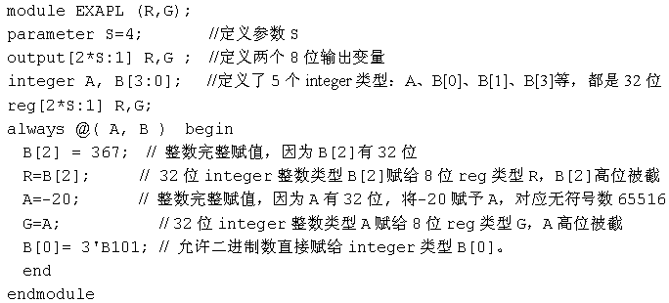
3.4 组合逻辑乘法器设计
3.4.2 整数型寄存器类型定义

Slide 33
3.4 组合逻辑乘法器设计
3.4.3 for语句用法

Slide 34

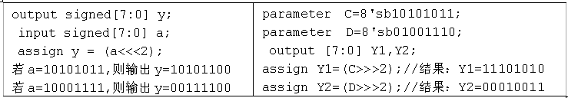
3.4 组合逻辑乘法器设计
3.4.4 移位操作符及其用法

Slide 35
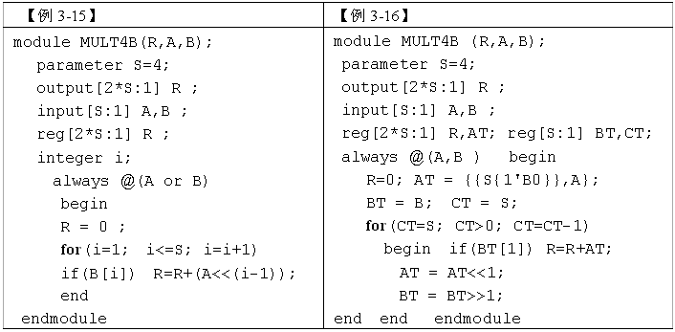
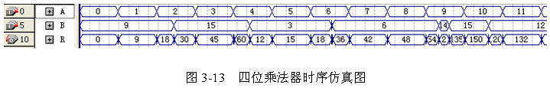
3.4 组合逻辑乘法器设计
3.4.5 两则乘法器设计示例

Slide 36

3.4 组合逻辑乘法器设计
3.4.6 repeat语句用法

Slide 37

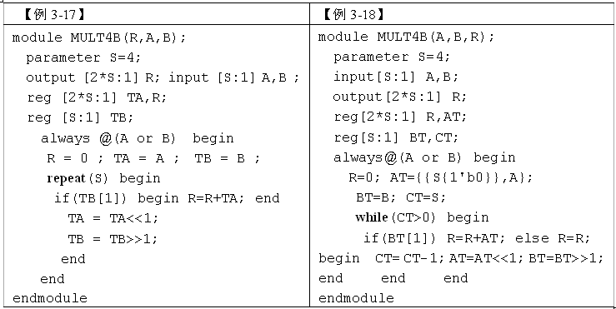
3.4 组合逻辑乘法器设计
3.4.7 while语句用法

Slide 38

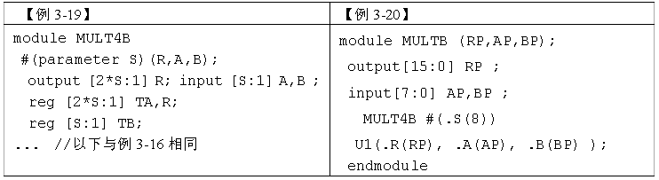
3.4 组合逻辑乘法器设计
3.4.8 parameter的参数传递功能

Slide 39
时序电路的Verilog设计

Slide 40
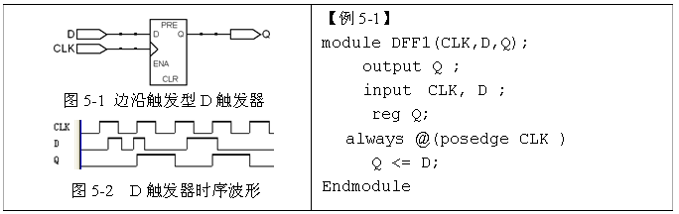
5.1 基本时序元件的Verilog表述
5.1.1 基本D触发器及其Verilog表述

Slide 41
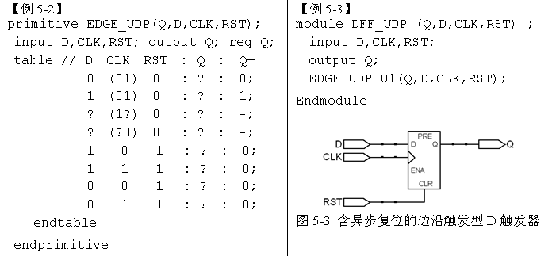
5.1 基本时序元件的Verilog表述
5.1.2 用UDP表述D触发器

Slide 42
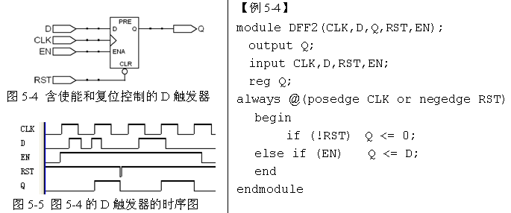
5.1 基本时序元件的Verilog表述
5.1.3 含异步复位和时钟使能的D触发器及其Verilog表述

Slide 43
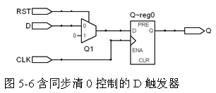
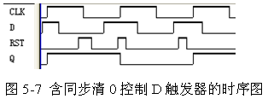
5.1 基本时序元件的Verilog表述
5.1.4 含同步复位控制的D触发器及其Verilog表述

Slide 44
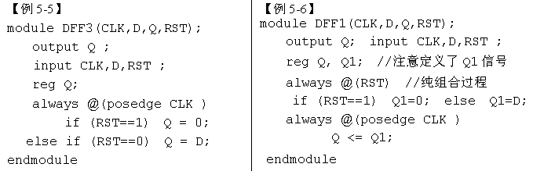
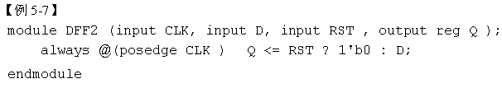
5.1 基本时序元件的Verilog表述
5.1.4 含同步复位控制的D触发器及其Verilog表述

Slide 45
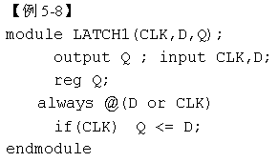
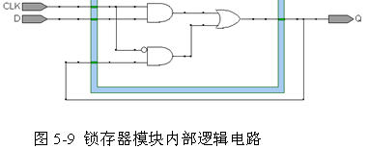


5.1 基本时序元件的Verilog表述
5.1.5 基本锁存器及其Verilog表述

Slide 46
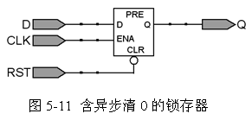
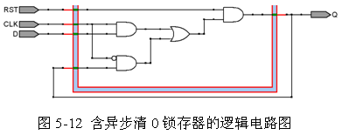
5.1 基本时序元件的Verilog表述
5.1.6 含清0控制的锁存器及其Verilog表述

Slide 47
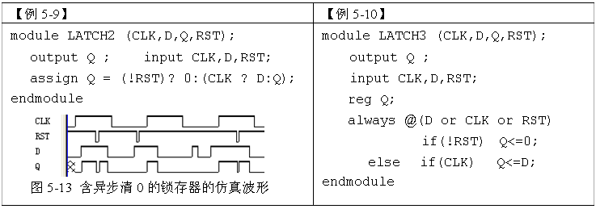
5.1 基本时序元件的Verilog表述
5.1.6 含清0控制的锁存器及其Verilog表述

Slide 48
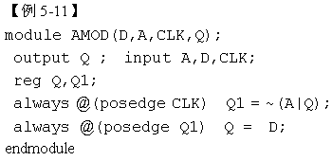
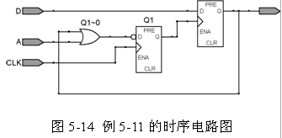
5.1 基本时序元件的Verilog表述
5.1.7 异步时序电路的Verilog表述特点

Slide 49


5.1 基本时序元件的Verilog表述
5.1.8 时钟过程表述的特点和规律

Slide 50
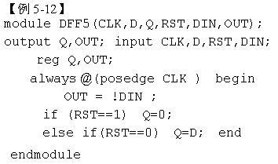
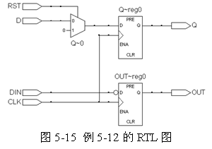
5.1 基本时序元件的Verilog表述
5.1.8 时钟过程表述的特点和规律

Slide 51


5.2 二进制计数器及其Verilog表述
5.2.1 简单加法计数器及其Verilog表述

Slide 52

5.2 二进制计数器及其Verilog表述
5.2.1 简单加法计数器及其Verilog表述

Slide 53

5.2 二进制计数器及其Verilog表述
5.2.2 实用加法计数器设计

Slide 54

5.2 二进制计数器及其Verilog表述
5.2.2 实用加法计数器设计

Slide 55

5.2 二进制计数器及其Verilog表述
5.2.2 实用加法计数器设计

Slide 56


5.3 移位寄存器的Verilog表述与设计
5.3.1 含同步预置功能的移位寄存器设计

Slide 57

5.3 移位寄存器的Verilog表述与设计
5.3.2 使用移位操作符设计移位寄存器

Slide 58

5.4 可预置型计数器设计
5.4.1 同步加载计数器

Slide 59


5.4 可预置型计数器设计
5.4.1 同步加载计数器

Slide 60


5.4 可预置型计数器设计
5.4.2 异步加载计数器

Slide 61



5.4 可预置型计数器设计
5.4.3 异步清0加载计数器

Slide 62

5.4 可预置型计数器设计
5.4.3 异步清0加载计数器

Slide 63


5.4 可预置型计数器设计
5.4.4 同步清0加载计数器

Slide 64



Slide 65


Slide 66
Data Path Design

Slide 67


Slide 68


Slide 69


Slide 70


Slide 71


Slide 72


Slide 73


Slide 74
Finite State Machine (FSM)

Slide 75

Finite-State Machines (FSMs) and Controllers
Want sequential circuit with particular behavior over time
Example: Laser timer
  Push button: x=1 for 3 clock cycles
  How? Let’s try three flip-flops
    b=1 gets stored in first D flip-flop
    Then 2nd flip-flop on next cycle, then 3rd flip-flop on next
    OR the three flip-flop outputs, so x should be 1 for three cycles
b
Controller
x
laser
clk
patient

Slide 76
Need a Better Way to Design Sequential Circuits
Trial and error is not a good design method
  Will we be able to “guess” a circuit that works for other desired behavior?
    How about counting up from 1 to 9? Pulsing an output for 1 cycle every 10 cycles? Detecting the sequence 1 3 5 in binary on a 3-bit input?
  And, a circuit built by guessing may have undesired behavior
    Laser timer: What if press button again while x=1? x then stays one another 3 cycles. Is that what we want?
Combinational circuit design process had two important things
  A formal way to describe desired circuit behavior
    Boolean equation, or truth table
  A well-defined process to convert that behavior to a circuit
We need those things for sequence circuit design

Slide 77

Describing Behavior of Sequential Circuit: FSM
Finite-State Machine (FSM)
  A way to describe desired behavior of sequential circuit
    Akin to Boolean equations for combinational behavior
  List states, and transitions among states
    Example: Make x change toggle (0 to 1, or 1 to 0) every clock cycle
    Two states: “Off” (x=0), and “On” (x=1)
    Transition from Off to On, or On to Off, on rising clock edge
    Arrow with no starting state points to initial state (when circuit first starts)
Outputs: x
x=0
clk
^
x=1
O
ff
On
clk
^

Slide 78
FSM Example: 0,1,1,1,repeat
Want 0, 1, 1, 1, 0, 1, 1, 1, ...
  Each value for one clock cycle
Can describe as FSM
  Four states
  Transition on rising clock edge to next state
Outputs: x
x=0
clk
^
x=1
clk
^
x=1
clk
^
x=1
O
ff
On1
On2
On3
clk
^
clk
State
O
ff
On1
On2
On3
O
ff
On1
On2
On3
O
ff
Outputs:
x

Slide 79

Extend FSM to Three-Cycles High Laser Timer
Four states
Wait in “Off” state while b is 0 (b’)
When b is 1 (and rising clock edge), transition to On1
  Sets x=1
  On next two clock edges, transition to On2, then On3, which also set x=1
So x=1 for three cycles after button pressed
Inputs: b; Outputs: x
x=0
clk
^
O
ff
b
’*clk
^
b*clk
^
x=1
clk
^
x=1
clk
^
x=1
On1
On2
On3

Slide 80
FSM Simplification: Rising Clock Edges Implicit
Showing rising clock on every transition: cluttered
  Make implicit -- assume every edge has rising clock, even if not shown
  What if we wanted a transition without a rising edge
    We don’t consider such asynchronous FSMs -- less common, and advanced topic
    Only consider synchronous FSMs -- rising edge on every transition
Inputs: b; Outputs: x
x=0
clk
^
O
ff
b’
*clk
^
b
*clk
^
x=1
clk
^
x=1
clk
^
x=1
On1
On2
On3
Inputs: b; Outputs: x
x=0
Off
b
’
b
x=1
x=1
x=1
On1
On2
On3
Note: Transition with no associated condition thus transistions to next state on next clock cycle

Slide 81
FSM Definition
FSM consists of
  Set of states
    Ex: {Off, On1, On2, On3}
  Set of inputs, set of outputs
    Ex: Inputs: {x}, Outputs: {b}
  Initial state
    Ex: “Off”
  Set of transitions
    Describes next states
    Ex: Has 5 transitions
  Set of actions
    Sets outputs while in states
    Ex: x=0, x=1, x=1, and x=1
Inputs: b; Outputs: x
x=0
Off
b
’
b
x=1
x=1
x=1
On1
On2
On3
We often draw FSM graphically, known as state diagram
Can also use table (state table), or textual languages

Slide 82
Standard Controller Architecture
How implement FSM as sequential circuit?
  Use standard architecture
    State register -- to store the present state
    Combinational logic -- to compute outputs, and next state
    For laser timer FSM
      2-bit state register, can represent four states
      Input b, output x
  Known as controller
Inputs: b; Outputs: x
x=0
Off
b
’
b
x=1
x=1
x=1
On1
On2
On3
FSM
inputs
b
x
FSM
outputs
Combinational
logic
n1
FSM
inputs
I
O
FSM
outputs
n0
Combinational
logic
s1
s0
S
m
clk
State register
clk
m-bit
state register
m
N
General version

Slide 83
Finite-State Machines (FSMs)—Sequential Behavior
Finite-state machine (FSM) is a common model of sequential behavior
  Example: If B=1, hold X=1 for 3 clock cycles
    Note: Transitions implicitly ANDed with rising clock edge
  Implementation model has two parts:
    State register
    Combinational logic
  HDL model will reflect those two parts
Inputs: B; Outputs: X
X=0
Off
B
B
X=1
X=1
X=1
On1
On2
On3
FSM
inputs
B
X
FSM
outputs
Combinational
logic
State
Clk
State register
StateNext

Slide 84
Finite-State Machines (FSMs)—Sequential Behavior
Modules with Multiple Procedures and Shared Variables
Inputs: B; Outputs: X
`timescale 1 ns/1 ns
module LaserTimer(B, X, Clk, Rst);
input B;
output reg X;
input Clk, Rst;
parameter S_Off = 0, S_On1 = 1,
S_On2 = 2, S_On3 = 3;
reg [1:0] State, StateNext;
// CombLogic
always @(State, B) begin
case (State)
S_Off: begin
X <= 0;
if (B == 0)
StateNext <= S_Off;
else
StateNext <= S_On1;
end
...
...
S_On1: begin
X <= 1;
StateNext <= S_On2;
end
S_On2: begin
X <= 1;
StateNext <= S_On3;
end
S_On3: begin
X <= 1;
StateNext <= S_Off;
end
endcase
end
// StateReg
always @(posedge Clk) begin
if (Rst == 1 )
State <= S_Off;
else
State <= StateNext;
end
endmodule
X=0
Off
B
B
X=1
X=1
X=1
On1
On2
On3
FSM
inputs
B
X
FSM
outputs
Combinational
logic
State
Clk
State register
StateNext
Code will be explained on following slides

Slide 85
Finite-State Machines (FSMs)—Sequential Behavior
Modules has two procedures
  One procedure for combinational logic
  One procedure for state register
  But it's still a behavioral description
`timescale 1 ns/1 ns
module LaserTimer(B, X, Clk, Rst);
input B;
output reg X;
input Clk, Rst;
parameter S_Off = 0, S_On1 = 1,
S_On2 = 2, S_On3 = 3;
reg [1:0] State, StateNext;
// CombLogic
always @(State, B) begin
...
end
// StateReg
always @(posedge Clk) begin
...
end
endmodule
FSM
inputs
B
X
FSM
outputs
Combinational
logic
State
Clk
State register
StateNext

Slide 86
Finite-State Machines (FSMs)—Sequential Behavior
Parameters
parameter declaration
  Not a variable or net, but rather a constant
  A constant is a value that must be initialized, and that cannot be changed within the module’s definition
  Four parameters defined
    S_Off, S_On1, S_On2, S_On3
    Correspond to FSM’s states
      Should be initialized to unique values
`timescale 1 ns/1 ns
module LaserTimer(B, X, Clk, Rst);
input B;
output reg X;
input Clk, Rst;
parameter S_Off = 0, S_On1 = 1,
S_On2 = 2, S_On3 = 3;
reg [1:0] State, StateNext;
// CombLogic
always @(State, B) begin
...
end
// StateReg
always @(posedge Clk) begin
...
end
endmodule

Slide 87
Finite-State Machines (FSMs)—Sequential Behavior
Module declares two reg variables
  State, StateNext
  Each is 2-bit vector (need two bits to represent four unique state values 0 to 3)
  Variables are shared between CombLogic and StateReg procedures
CombLogic procedure
  Event control sensitive to State and input B
  Will output StateNext and X
StateReg procedure
  Sensitive to Clk input
  Will output State, which it stores
`timescale 1 ns/1 ns
module LaserTimer(B, X, Clk, Rst);
input B;
output reg X;
input Clk, Rst;
parameter S_Off = 0, S_On1 = 1,
S_On2 = 2, S_On3 = 3;
reg [1:0] State, StateNext;
// CombLogic
always @(State, B) begin
...
end
// StateReg
always @(posedge Clk) begin
...
end
endmodule
FSM
inputs
B
X
FSM
outputs
Combinational
logic
State
Clk
State register
StateNext

Slide 88
Finite-State Machines (FSMs)—Sequential Behavior
Procedures with Case Statements
Procedure may use case statement
  Preferred over if-else-if when just one expression determines which statement to execute
  case (expression)
    Execute statement whose case item expression value matches case expression
      case item expression : statement
      statement is commonly a begin-end block, as in example
  First case item expression that matches executes; remaining case items ignored
  If no item matches, nothing executes
  Last item may be "default : statement"
    Statement executes if none of the previous items matched
// CombLogic
always @(State, B) begin
case (State)
S_Off: begin
X <= 0;
if (B == 0)
StateNext <= S_Off;
else
StateNext <= S_On1;
end
S_On1: begin
X <= 1;
StateNext <= S_On2;
end
S_On2: begin
X <= 1;
StateNext <= S_On3;
end
S_On3: begin
X <= 1;
StateNext <= S_Off;
end
endcase
end

Slide 89
Finite-State Machines (FSMs)—Sequential Behavior
Procedures with Case Statements
FSM’s CombLogic procedure
  Case statement describes states
  case (State)
    Executes corresponding statement (often a begin-end block) based on State's current value
  A state's statements consist of
    Actions of the state
    Setting of next state (transitions)
Ex: State is S_On1
  Executes statements for state On1, jumps to endcase
reg [1:0] State, StateNext;
// CombLogic
always @(State, B) begin
case (State)
S_Off: begin
X <= 0;
if (B == 0)
StateNext <= S_Off;
else
StateNext <= S_On1;
end
S_On1: begin
X <= 1;
StateNext <= S_On2;
end
S_On2: begin
X <= 1;
StateNext <= S_On3;
end
S_On3: begin
X <= 1;
StateNext <= S_Off;
end
endcase
end
Suppose State is S_On1
Inputs: X; Outputs: B
X=0
Off
B'
B
X=1
X=1
X=1
On1
On2
On3

Slide 90
Finite-State Machines (FSMs)—Sequential Behavior
FSM StateReg Procedure
  Similar to 4-bit register
    Register for State is 2-bit vector reg variable
  Procedure has synchronous reset
    Resets State to FSM’s initial state, S_Off
...
parameter S_Off = 0, S_On1 = 1,
S_On2 = 2, S_On3 = 3;
reg [1:0] State, StateNext;
...
// StateReg
always @(posedge Clk) begin
if (Rst == 1 )
State <= S_Off;
else
State <= StateNext;
end
...

Slide 91
Finite-State Machines (FSMs)—Sequential Behavior
Modules with Multiple Procedures and Shared Variables
Inputs: B; Outputs: X
`timescale 1 ns/1 ns
module LaserTimer(B, X, Clk, Rst);
input B;
output reg X;
input Clk, Rst;
parameter S_Off = 0, S_On1 = 1,
S_On2 = 2, S_On3 = 3;
reg [1:0] State, StateNext;
// CombLogic
always @(State, B) begin
case (State)
S_Off: begin
X <= 0;
if (B == 0)
StateNext <= S_Off;
else
StateNext <= S_On1;
end
...
...
S_On1: begin
X <= 1;
StateNext <= S_On2;
end
S_On2: begin
X <= 1;
StateNext <= S_On3;
end
S_On3: begin
X <= 1;
StateNext <= S_Off;
end
endcase
end
// StateReg
always @(posedge Clk) begin
if (Rst == 1 )
State <= S_Off;
else
State <= StateNext;
end
endmodule
X=0
Off
B
B
X=1
X=1
X=1
On1
On2
On3
FSM
inputs
B
X
FSM
outputs
Combinational
logic
State
Clk
State register
StateNext
Code should now be clear

Slide 92
Finite-State Machines (FSMs)—Sequential Behavior
Self-Checking Testbenches
...
// Clock Procedure
always begin
Clk_s <= 0;
#10;
Clk_s <= 1;
#10;
end // Note: Procedure repeats
// Vector Procedure
initial begin
Rst_s <= 1;
B_s <= 0;
@(posedge Clk_s);
#5 Rst_s <= 0;
@(posedge Clk_s);
#5 B_s <= 1;
@(posedge Clk_s);
#5 B_s <= 0;
@(posedge Clk_s);
@(posedge Clk_s);
@(posedge Clk_s);
end
endmodule
FSM testbench
  First part of file (variable/net declarations, module instantiations) similar to before
  Vector Procedure
    Resets FSM
    Sets FSM's input values (“test vectors”)
    Waits for specific clock cycles
  We observe the resulting waveforms to determine if FSM behaves correctly
Clk_s
Rst_s
B_s
X_s
10
20
30
40
50
60
70
80
90
100
110
time (ns)

Slide 93
Finite-State Machines (FSMs)—Sequential Behavior
Self-Checking Testbenches
Reading waveforms is error-prone
Create self-checking testbench
  Use if statements to check for expected values
    If a check fails, print error message
    Ex: if X_s fell to 0 one cycle too early, simulation might output:
      95: Third X=1 failed
// Vector Procedure
initial begin
Rst_s <= 1;
B_s <= 0;
@(posedge Clk_s);
#5 if (X_s != 0)
$display("%t: Reset failed", $time);
Rst_s <= 0;
@(posedge Clk_s);
#5 B_s <= 1;
@(posedge Clk_s);
#5 B_s <= 0;
if (X_s != 1)
$display("%t: First X=1 failed", $time);
@(posedge Clk_s);
#5 if (X_s != 1)
$display("%t: Second X=1 failed", $time);
@(posedge Clk_s);
#5 if (X_s != 1)
$display("%t: Third X=1 failed", $time);
@(posedge Clk_s);
#5 if (X_s != 0)
$display("%t: Final X=0 failed", $time);
end
Clk_s
Rst_s
B_s
X_s
10
20
30
40
50
60
70
80
90
100
110
time (ns)

Slide 94
Finite-State Machines (FSMs)—Sequential Behavior
$display System Procedure
$display – built-in Verilog system procedure for printing information to display during simulation
  A system procedure interacts with the simulator and/or host computer system
    To write to a display, read a file, get the current simulation time, etc.
    Starts with $ to distinguish from regular procedures
String argument is printed literally...
  $display("Hello") will print "Hello"
  Automatically adds newline character
...except when special sequences appear
  %t: Display a time expression
  Time expression must be next argument
    $time – Built-in system procedure that returns the current simulation time
      95: Third X=1 failed
// Vector Procedure
initial begin
Rst_s <= 1;
B_s <= 0;
@(posedge Clk_s);
#5 if (X_s != 0)
$display("%t: Reset failed", $time);
Rst_s <= 0;
@(posedge Clk_s);
#5 B_s <= 1;
@(posedge Clk_s);
#5 B_s <= 0;
if (X_s != 1)
$display("%t: First X=1 failed", $time);
@(posedge Clk_s);
#5 if (X_s != 1)
$display("%t: Second X=1 failed", $time);
@(posedge Clk_s);
#5 if (X_s != 1)
$display("%t: Third X=1 failed", $time);
@(posedge Clk_s);
#5 if (X_s != 0)
$display("%t: Final X=0 failed", $time);
end

Slide 95

Controller Example:
Button Press Synchronizer
bi
Button press
synchronizer
controller
bo
Want simple sequential circuit that converts button press to single cycle duration, regardless of length of time that button actually pressed
  We assumed such an ideal button press signal in earlier example, like the button in the laser timer controller

Slide 96

Controller Example:
Button Press Synchronizer (cont)
FSM inputs: bi; FSM outputs: bo
FSM
inputs
bi
bo
FSM
outputs
Step 2: Create architecture
Combinational
logic
bi
’
bi
n1
b
’
i
bi
’
n0
A
bi
B
bi
C
s1
s0
n1 = s1’s0bi + s1s0bi
n0 = s1’s0’bi
bo = s1’s0bi’ + s1’s0bi = s1s0
bo=0
bo=1
bo=0
clk
State register
Step 1: FSM
Combinational logic
outputs
bo
bi
FSM
n1
FSM inputs: bi; FSM outputs: bo
bi
’
bi
n0
bi
’
bi
’
00
bi
01
bi
10
s1
s0
bo=0
bo=1
bo=0
State register
Step 3: Encode states
clk
Step 4: State table
Step 5: Create combinational circuit
Step 5: Create combinational circuit

Slide 97

Controller Example: Sequence Generator
Want generate sequence 0001, 0011, 1100, 1000, (repeat)
  Each value for one clock cycle
  Common, e.g., to create pattern in 4 lights, or control magnets of a “stepper motor”
Inputs: none; Outputs: w,x,y,z
w
x
Inputs: none; Outputs: w,x,y,z
wxyz=0001
wxyz=1000
Combinational
logic
y
wxyz=0001
wxyz=1000
z
A
D
n1
A
00
D
11
n0
s1
s0
01
10
B
C
clk
State register
B
C
wxyz=0011
wxyz=1100
wxyz=0011
wxyz=1100
Step 1: Create FSM
Step 2: Create architecture
Step 3: Encode states
w
FSM outputs
w = s1
x = s1s0’
y = s1’s0
z = s1’
n1 = s1 xor s0
n0 = s0’
x
y
z
s1
s0
n0
n1
clk
State register
Step 4: Create state table
Step 5: Create combinational circuit

Slide 98
Initial State of a Controller
All our FSMs had initial state
  But our sequential circuit designs did not
  Can accomplish using flip-flops with reset/set inputs
    Shown circuit initializes flip-flops to 01
  Designer must ensure reset input is 1 during power up of circuit
    By electronic circuit design
Inputs: x; Outputs: b
x=0
Off
b
’
b
x=1
x=1
x=1
On1
On2
On3
b
x
Combinational
logic
n1
n0
s1
s0
State register
clk
D
Q
’
D
Q
’
R
Q
S
Q
reset

Slide 99
Describing Safe FSMs
Safe FSM – If enters illegal state, transitions to a legal state
Example
  Suppose example has only three states
  Two-bit encoding has illegal state encoding "11"
    Also known as "unreachable" state
    Not possible to enter that state under normal FSM operation
    But actually possible to enter that state due to circuit error – e.g., electrical noise that causes state register bit to switch
Inputs: B; Outputs: X
X=0
00
B'
O
ff
B
X=1
X=1
01
On1
10
On2

Slide 100
Describing Safe FSMs
Safe FSM – If enters illegal state, transitions to a legal state
Example
  Suppose example has only three states
  Two-bit encoding has illegal state encoding "11"
  Safe implementation
    Transition to appropriate legal state
    Even though that undefined state appears to be unreachable
    Thus, FSM recovers from the error
Inputs: B; Outputs: X
X=0
X=0
00
B'
11
O
ff
B
X=1
X=1
01
On1
10
On2

Slide 101
Describing Safe FSMs in Verilog HDL
Unsafe FSM description
  Only describes legal states, ignores illegal states
Some synthesis tools support "safe" option during synthesis
  Automatically creates safe FSM from an unsafe FSM description
...
reg [1:0] State, StateNext;
always @(State, B) begin
case (State)
S_Off: begin
X <= 0;
if (B == 0)
StateNext <= S_Off;
else
StateNext <= S_On1;
end
S_On1: begin
X <= 1;
StateNext <= S_On2;
end
S_On2: begin
X <= 1;
StateNext <= S_Off;
end
endcase
end
...

Slide 102
Describing Safe FSMs in Verilog HDL
Explicitly describing a safe FSM
  Include case item(s) to describe illegal states
  Can use "default" case item
    Executes if State equals anything other than S_Off, S_On1, or S_On2
Note: Use of default is wise regardless of number of states
  Even if number is power of two, because state encoding may use more than minimum number of bits
    e.g., one-hot encoding has many more illegal states than legal states
Note: If synthesis tool support "safe" option, use it
  Otherwise, tool may automatically optimize away unreachable states to improve performance and size, but making state machine unsafe
...
reg [1:0] State, StateNext;
always @(State, B) begin
case (State)
S_Off: begin
X <= 0;
if (B == 0)
StateNext <= S_Off;
else
StateNext <= S_On1;
end
S_On1: begin
X <= 1;
StateNext <= S_On2;
end
S_On2: begin
X <= 1;
StateNext <= S_Off;
end
default: begin
X <= 0;
StateNext <= S_Off;
end
endcase
end
...

Slide 103
Verilog设计深入

Slide 104




Slide 105
Resets
I
3
I
2
I
1
I
0
Reset – Behavior of a register when a reset input is asserted
Good practice dictates having defined reset behavior for every register
Reset behavior should always have priority over normal register behavior
Reset behavior
  Usually clears register to 0s
  May initialize to other value
    e.g., state register of a controller may be initialized to encoding of initial state of FSM
Reset usually asserted externally at start of sequential circuit operation, but also to restart due to failure, user request, or other reason
reg(4)
Rst
Q3
Q2
Q1
Q0
`timescale 1 ns/1 ns
module Reg4(I, Q, Clk, Rst);
input [3:0] I;
output [3:0] Q;
reg [3:0] Q;
input Clk, Rst;
always @(posedge Clk) begin
if (Rst == 1 )
Q <= 4'b0000;
else
Q <= I;
end
endmodule

Slide 106

Synchronous Reset
I
3
I
2
I
1
I
0
Previous examples used synchronous resets
  Rst input only considered during rising clock
reg(4)
Rst
Q3
Q2
Q1
Q0
`timescale 1 ns/1 ns
module Reg4(I, Q, Clk, Rst);
input [3:0] I;
output [3:0] Q;
reg [3:0] Q;
input Clk, Rst;
always @(posedge Clk) begin
if (Rst == 1 )
Q <= 4'b0000;
else
Q <= I;
end
endmodule
I
Q
xxxx
Clk
Rst
Rst=1 has no effect until rising clock

Slide 107

Asynchronous Reset
I
3
I
2
I
1
I
0
Can also use asynchronous reset
  Rst input considered independently from clock
    Add "posedge Rst" to sensitivity list
reg(4)
Rst
Q3
Q2
Q1
Q0
`timescale 1 ns/1 ns
module Reg4(I, Q, Clk, Rst);
input [3:0] I;
output [3:0] Q;
reg [3:0] Q;
input Clk, Rst;
always @(posedge Clk, posedge Rst) begin
if (Rst == 1 )
Q <= 4'b0000;
else
Q <= I;
end
endmodule
I
Q
Clk
Rst
Asynchronous reset
Rst=1 has almost immediate effect
I
Q
xxxx
Clk
Rst
Synchronous reset
Rst=1 has no effect until next rising clock

Slide 108
Asynchronous Reset
Could have used asynchronous reset for FSM state register too
...
// StateReg
always @(posedge Clk) begin
if (Rst == 1 )
State <= S_Off;
else
State <= StateNext;
end
...
Synchronous
...
// StateReg
always @(posedge Clk, posedge Rst) begin
if (Rst == 1 )
State <= S_Off;
else
State <= StateNext;
end
...
Asynchronous

Slide 109
Synchronous versus Asynchronous Resets
Which is better – synchronous or asynchronous reset?
  Hotly debated in design community
    Each has pros and cons
      e.g., asynchronous can still reset even if clock is not functioning, synchronous avoids timing analysis problems sometimes accompanying asynchronous designs
    We won’t try to settle the debate here
  What’s important is to be consistent throughout a design
    All registers should have defined reset behavior that takes priority over normal register behavior
    That behavior should all be synchronous reset or all be asynchronous reset
  We will use synchronous resets in all of our remaining examples

